Slide 1
Chapter One
The Nation’s Beginnings, Prehistory-1824

Slide 2
Section 1 Vocabulary
Clan: extended family groups
The Middle Passage: the forced transport of enslaved Africans from West Africa to the Americas.
Christopher Columbus: Spanish explorer, reached Caribbean islands instead of reaching India in 1492. Signaled the Columbian Exchange.
Conquistador: Spanish conqueror
Columbian Exchange: the global exchange of goods, ideas, livestock, and diseases after Columbus made first transatlantic voyage in 1492.

Slide 3
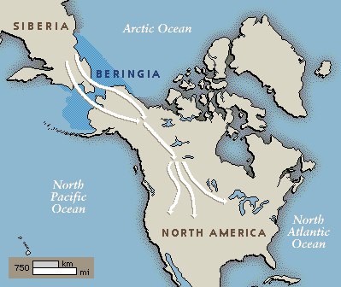
The Bering Land Bridge Small packs of nomads reached the Americas through the Bering Land Bridge. Connected Eurasia With North America 35,000 years ago.

Slide 4
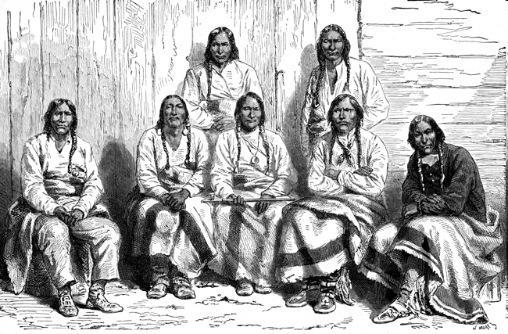
Native Americans
Spoke at least 375 distinct languages.
Made up of family groups called clans.
Primarily hunters and gatherers.
Deep respect for nature.
Often matrilineal societies.

Slide 5
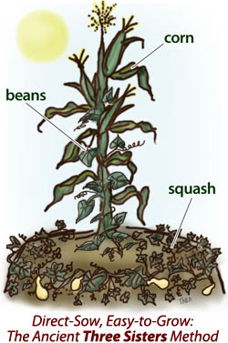
Three Sister Farming: Where beans grow on the trellis of the corn stalks, and where squash grows below in the soil.

Slide 6
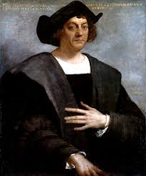
Christopher Columbus
In search of gold, spices, silk, and riches.
He hoped to reach the Indies of East Asia by sailing westward across the Atlantic.
However, he underestimated the size of the world and had no idea that the Americas were there to block his ships.
He explored several Caribbean islands. Convinced that the islands were the Indies, he called the natives “Indians.”

Slide 7
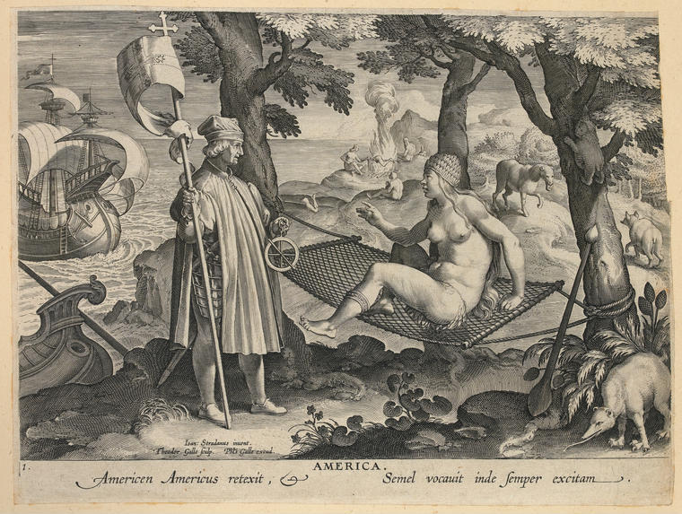

Slide 8
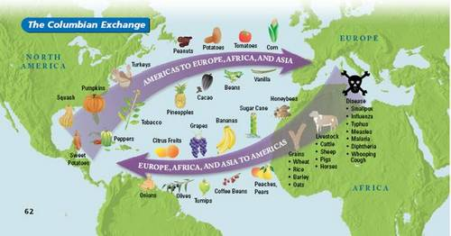
The Columbian Exchange

Slide 9
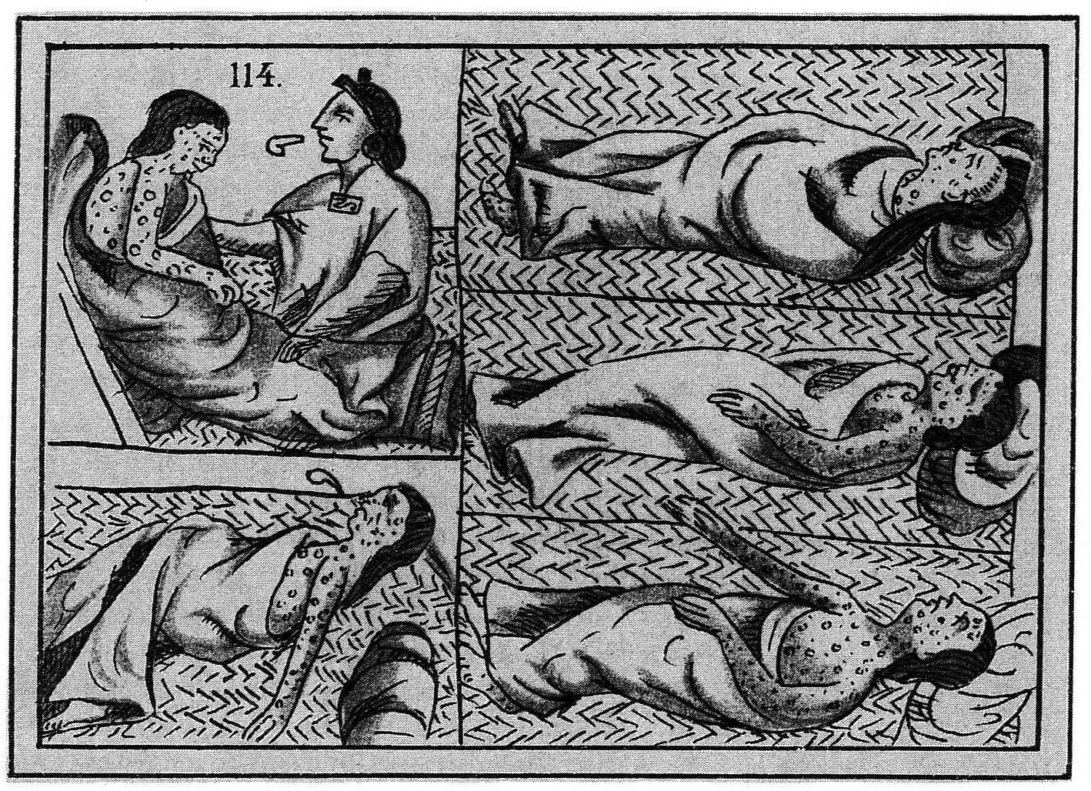

Slide 10
Conquistadores
Conquistador= Spanish word for Conqueror
In search of gold and glory.
Spanish invaders in both Central and South America.
Justified invading native peoples’ lands by claiming that they would “CHRISTIANIZE” the natives.
Hernando Cortes

Slide 11
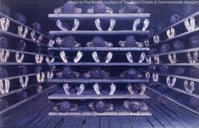
The Middle Passage

Slide 12
Section 2 Vocabulary
House of Burgesses: representative assembly of colonial Virginia formed in 1619
Mayflower Compact: it provided a framework for self-government
Enlightenment: European intellectual movement during the 1600’s and 1700’s.
Great Awakening: a religious movement that occurred in the colonies in the mid-1700’s
Magna Carta: limited kings ability to tax
Thomas Jefferson:
George Washington:

Slide 13
English Colonization
The Roanoke Colony was the English’s first attempt at colonization in 1584.
Colony mysteriously vanished.
Identified as the “Lost Colony.”
Queen Elizabeth I charted Sir Walter Raleigh.

Slide 14
Jamestown, Virginia
In 1607, the English established their first enduring settlement, Jamestown.
Due to John Rolfe’s discovery the colonists prospered by raising tobacco for export.
The House of Burgesses first representative assembly of colonial Virginia formed in 1619.
The “Starving Time.”
Pocahontas (Mataoka) John Smith, and Chief Powhatan.
The first slaves reach the New World (Jamestown) in 1619.
http://youtu.be/4p-bWA1FOqs

Slide 15
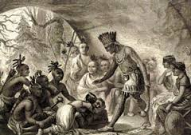
Pocahontas aka Mataoka

Slide 16
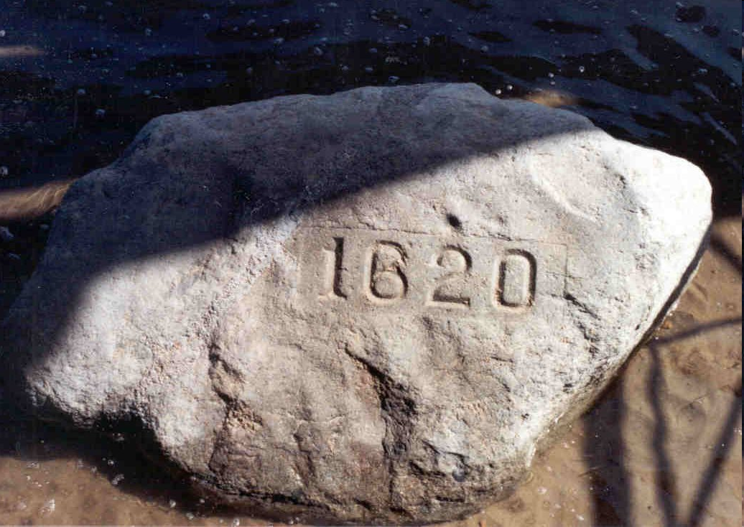
New England Colonies
Separatists (Pilgrims) and Puritans who hoped to create model, moral communities.
First settled in 1620 at Plymouth Rock, Massachusetts.
Adopted the Mayflower Compact, a framework for self-government.

Slide 17
Middle and Southern Colonies
Maryland: Tolerated ALL Christians.
New Jersey and Pennsylvania: Haven for Quakers.
North Carolina and South Carolina: Rice plantations.
Georgia=Buffer colony.

Slide 18
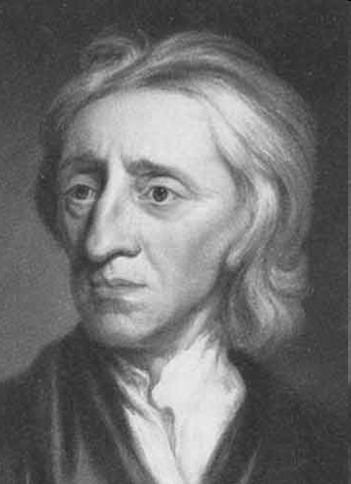
The Enlightenment and the Great Awakening
Frenchman Baron de Montesquieu and Englishman John Locke were two thinkers who applied reason to government and politics.
Enlightenment: Philosophy in which science and reason could solve problems.

Slide 19
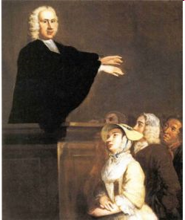
The Enlightenment and The Great Awakening
During the Great Awakening, evangelical preachers such as Jonathan Edwards and George Whitefield toured the colonies promoting revivals.

Slide 20
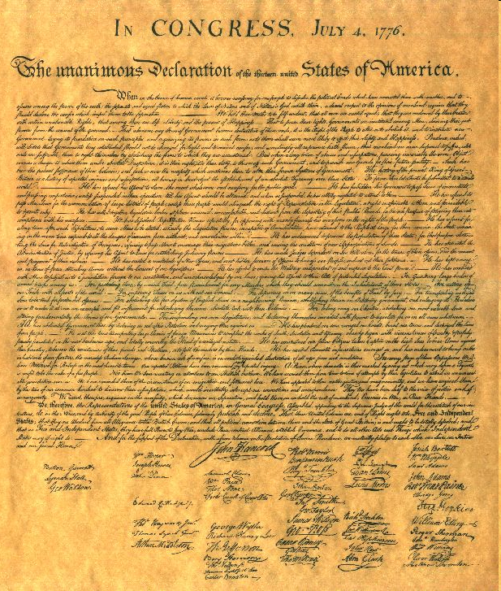
The Declaration of Independence
Thomas Jefferson= Father of the Declaration of Independence.
It declared American independence and listed colonist grievances against the British.
Expressed Enlightenment philosopher John Locke’s idea about the natural rights of people.
http://youtu.be/uZfRaWAtBVg

Slide 21
Causes of the American Revolution
The French and Indian War. (French and Natives v. Britain and American Colonists over land). Britain was in debt, began taxing colonists to make money.
Sugar Act, Stamp Act, Tea tax, Boston Massacre, Townshend Acts, Intolerable Acts.
Quartering troops.
“No Taxation Without Representation.”

Slide 22
The American Revolution
First battles: 1775, Lexington and Concord
George Washington General
French assistance
Patriots and loyalists
Continental Army v. the British (Red Coats)
Trapped the British army at Yorktown.
Treaty of Paris, 1783.

Slide 23
Section 3 Vocabulary
Bill of Rights: first ten amendments to the Constitution. Protects individual liberties.
Shay’s Rebellion: this rebellion high-lighted the weaknesses of the federal government (Articles of Confederation)
James Madison: “father of the Constitution,” proposed the Virginia plan.
Ratify: Official approval. Ratification of the constitution.
Federalism: a system that divided power between state governments and the federal government.
Separation of Powers: principle that divides power among the executive, legislative, and judicial branches of government
Checks and Balances: system in which each branch of government has the power to monitor and limit the actions of the other two.

Slide 24
In 1781, the 13 states adopted their first federal constitution (The Articles of Confederation)
The government also suffered from structural weaknesses.
There wasn’t a President. Each state, no matter how large or small, had a single vote in a unicameral congress.

Slide 25
Shay’s Rebellion
Daniel Shays
Unable to pay their debts, Shays and other farmers led a revolt against the Massachusetts government, which began to take their homes.
Exposed the weaknesses of the Articles of Confederation.
Realized the need for a strong, central government.

Slide 26
The New Jersey Plan
By 1787, many Americans agreed that the Articles of Confederation was flawed.
Favored by the small states, the proposed New Jersey Plan would count all states as equals.

Slide 27
The Virginia Plan
James Madison= Father of the Constitution.
The Virginia Plan proposed that the states with the larger populations would have more members.

Slide 28
The Great Compromise
Combination of the New Jersey and Virginia Plan.
Bicameral Body= 2 Houses
House of Representatives would be based on population (Virginia Plan).
Senate would have equal state representation. 2 from each state. (New Jersey Plan)

Slide 29
Federalists and Anti-Federalists
Supporters of the Constitution were known as Federalists.
Those who didn’t support the constitution were called Anti-federalists.

